Slide 1


Inspect & Underwrite
Notes:
Hi Everyone, this is team inspect and we present you our solution for the pax challenge

Slide 2
LIVE DEMO
😅
Notes:
We will start with the live demo.

Slide 3
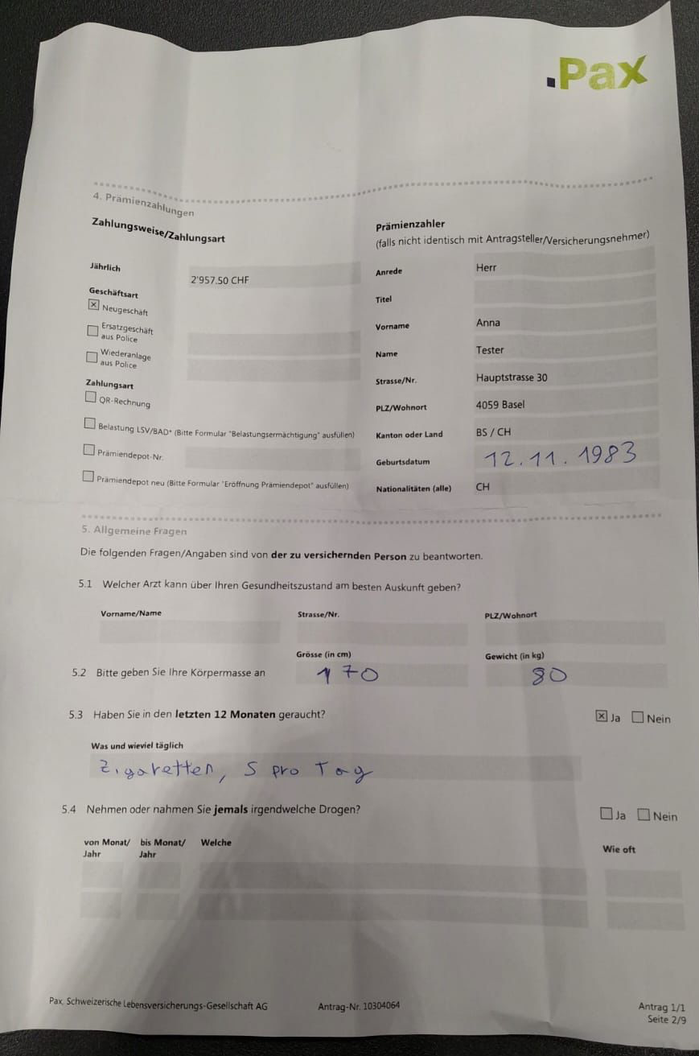
Data extraction from PDF
Notes:
As you saw our system can handle both pdf and manual data input in the web interface.

Slide 4
Data extraction from PDF
{
"BMI": 24.7,
"AGE": 32,
"SMOKER": false,
"PRACTICE_SPORT": true
}
Notes:
First we automatically parse pictures of the form.

Slide 5
Data extraction from PDF
multilingual
Sanity checks
Open Source model (Privacy)
{
"BMI": 24.7,
"AGE": 32,
"SMOKER": false,
"PRACTICE_SPORT": true
}
Notes:
This is done with an agentic pipeline, and our model is multilingual, does input sanity checks, and uses open source model for privacy.

Slide 6
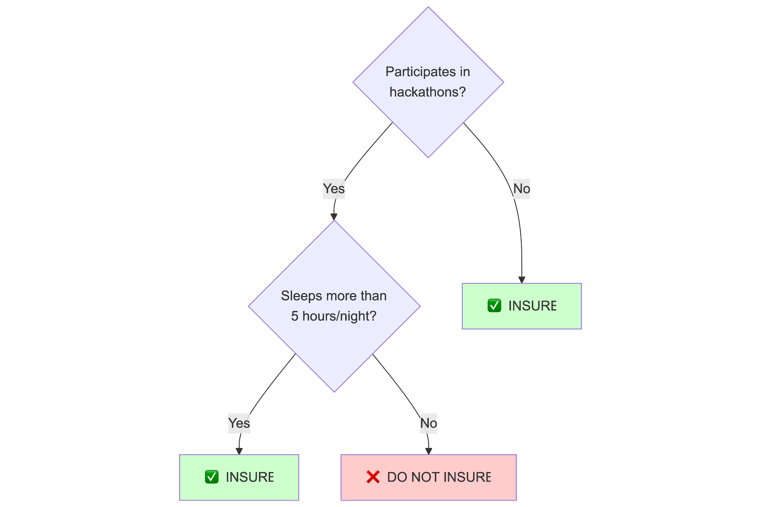
Rule based decision process
Notes:
Pax decision process is rule based, only workflow automation, AI only where its ok but not for decision making. The rules are all stored in a decision table.
(want to have control doesn’t want system to change stuff without their consent)

Slide 7
Automating the decision process
{
"BMI": 24.7,
"AGE": 32,
"SMOKER": false,
"PRACTICE_SPORT": true
}
RULES TABLE
AUTOMATED
DECISION
Notes:
Full control over important decision, only workflow automation, with AI only where its ok but not for decision making.
(want to have control doesn’t want system to change stuff without their consent)

Slide 8
Automating the decision process
Pax system is RULE BASED: if 22 < BMI < 35 and not smoker then Accept
{
"BMI": 24.7,
"AGE": 32,
"SMOKER": false,
"PRACTICE_SPORT": true
}
RULES TABLE
AUTOMATED
DECISION
Notes:
Full control over important decision, only workflow automation, with AI only where its ok but not for decision making.
(want to have control doesn’t want system to change stuff without their consent)

Slide 9



Automating the decision process
Pax system is RULE BASED: if 22 < BMI < 35 and not smoker => Accept
{
"BMI": 24.7,
"AGE": 32,
"SMOKER": false,
"PRACTICE_SPORT": true
}
RULES TABLE
AUTOMATED
DECISION
AUTOMATED
DECISION
Notes:
Full control over important decision, only workflow automation, with AI only where its ok but not for decision making.
(want to have control doesn’t want system to change stuff without their consent)

Slide 10
Automating the decision process
Pax system is RULE BASED: if 22 < BMI < 35 and not smoker => Accept
{
"BMI": 24.7,
"AGE": 32,
"SMOKER": false,
"PRACTICE_SPORT": true
}
RULES TABLE
AUTOMATED
DECISION
AUTOMATED
DECISION
Notes:
Full control over important decision, only workflow automation, with AI only where its ok but not for decision making.
(want to have control doesn’t want system to change stuff without their consent)

Slide 11
Automating the decision process
{
"BMI": 24.7,
"AGE": 32,
"SMOKER": false,
"DO_SPORT": true
}
RULES TABLE
AUTOMATED
DECISION
Notes:
The input information is matched to the rule table and the decision is made automatically,

Slide 12
Automating the decision process
{
"BMI": 24.7,
"AGE": 32,
"SMOKER": false,
"DO_SPORT": true
}
RULES TABLE
AUTOMATED
DECISION
AUTOMATED
DECISION
Notes:
however we know rules are made to be broken, and human intervention can change automatic rules based decisions.

Slide 13
Automating the decision process
{
"BMI": 24.7,
"AGE": 32,
"SMOKER": false,
"DO_SPORT": true
}
RULES TABLE
AUTOMATED
DECISION
AUTOMATED
DECISION
Reinforcement Learning loop
Notes:
Our system is using reinforcement learning to learn from its mistakes.

Slide 14
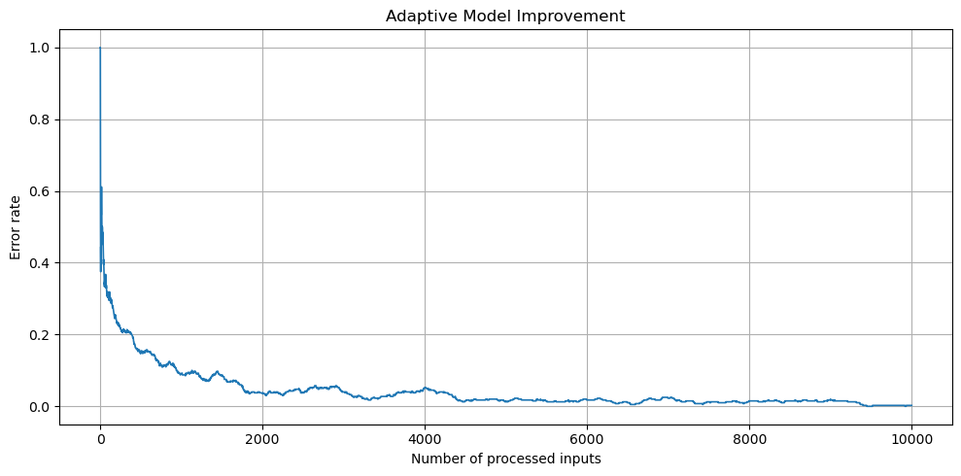
Improving the decision process
Monte Carlo simulation: learning from past mistake
Notes:
Here we see a simulation where we started with a rule table and we used a synthetic human to correct mistakes

Slide 15
Improving the decision process
Monte Carlo simulation: learning from past mistake
RULES TABLE
Notes:
In practice over time the rules tableapproach the human teacher

Slide 16
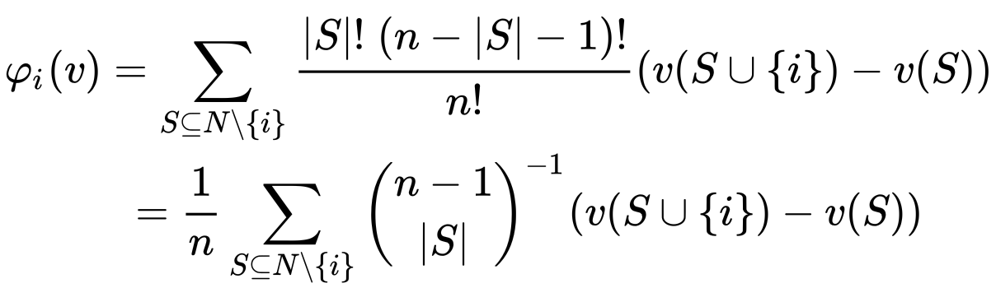
Justify a decision (How?)
Shapey value approach:
Notes:
It is fundamental to inform the client about why a decision was taken. However the rules are not indicating the exact reason. We edge shapey value approach to estimate which of the inputs yielded the decision.

Slide 17

Justify a decision (How?)
Shapey value approach:
Notes:
It is fundamental to inform the client about why a decision was taken. However the rules are not indicating the exact reason. We edge shapey value approach to estimate which of the inputs yielded the decision.

Slide 18
Shapey value example:
test_sample = pd.DataFrame({
"BMI": [25], "AGE": [86],
"SMOKER": [1],
"PRACTICE_SPORT": [0] })
rejected
BMI -0.008628
AGE 0.775515
SMOKER 0.005467
P_SPORT 0.108559
reason
Notes:
It is fundamental to inform the client about why a decision was taken. However the rules are not indicating the exact reason. We edge shapey value approach to estimate which of the inputs yielded the decision.

Slide 19
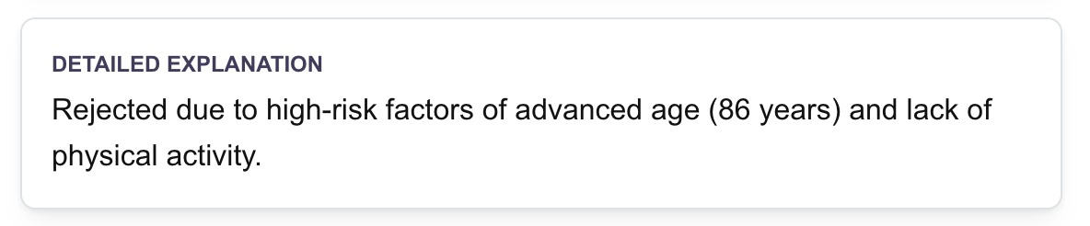
Shapey value example:
test_sample = pd.DataFrame({
"BMI": [25], "AGE": [86],
"SMOKER": [1],
"PRACTICE_SPORT": [0] })
rejected
BMI -0.008628
AGE 0.775515
SMOKER 0.005467
P_SPORT 0.108559
reason
Notes:
It is fundamental to inform the client about why a decision was taken. However the rules are not indicating the exact reason. We edge shapey value approach to estimate which of the inputs yielded the decision.

Slide 20
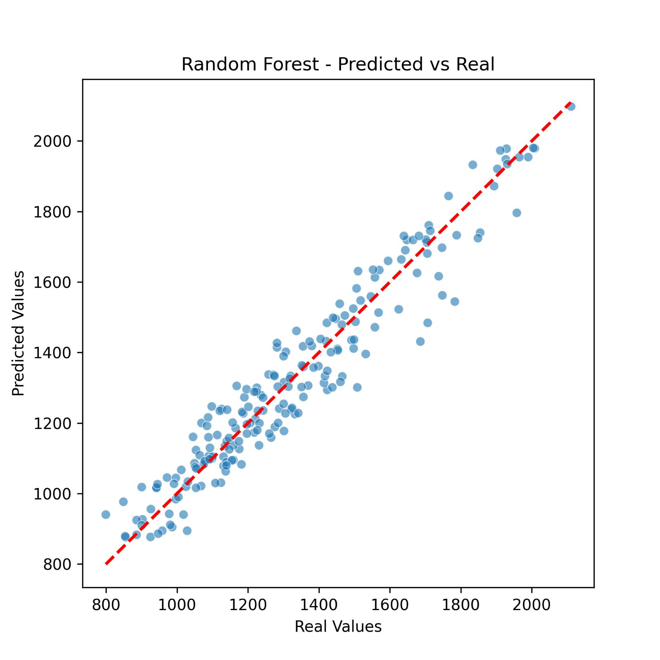
Predicting the price premium
Rule-Based => decision trees
(random forest)
We generated synthetic past
data regarding life insurance
We fit a prediction model for
% price premium from it

Slide 21
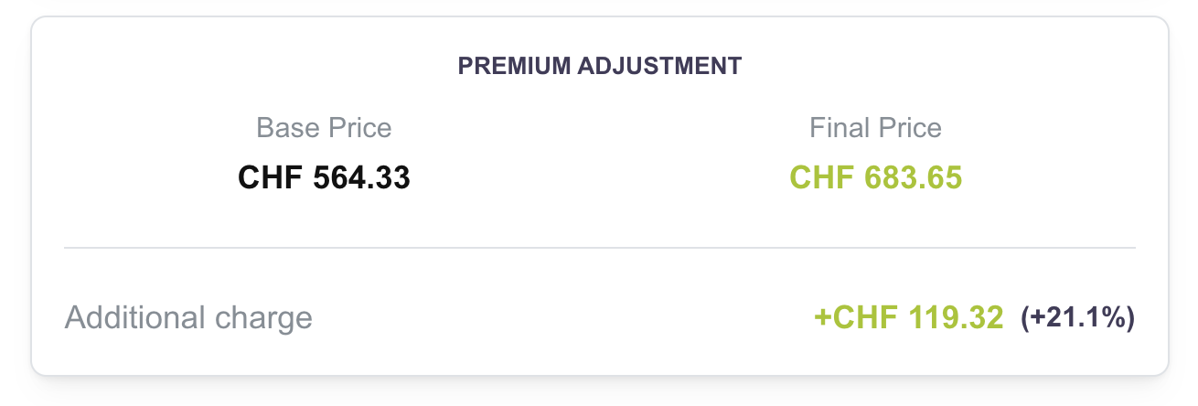
Predicting the price premium
Rule-Based => decision trees
(random forest)
We generated synthetic past
data regarding life insurance
We fit a prediction model for
% price premium from it

Slide 22

Monte Carlo Simulations
Ultra-Realistic sampling using swiss population data
Simulate rules effects on 10000 synthetic persons
Generate great visualizations

Slide 23
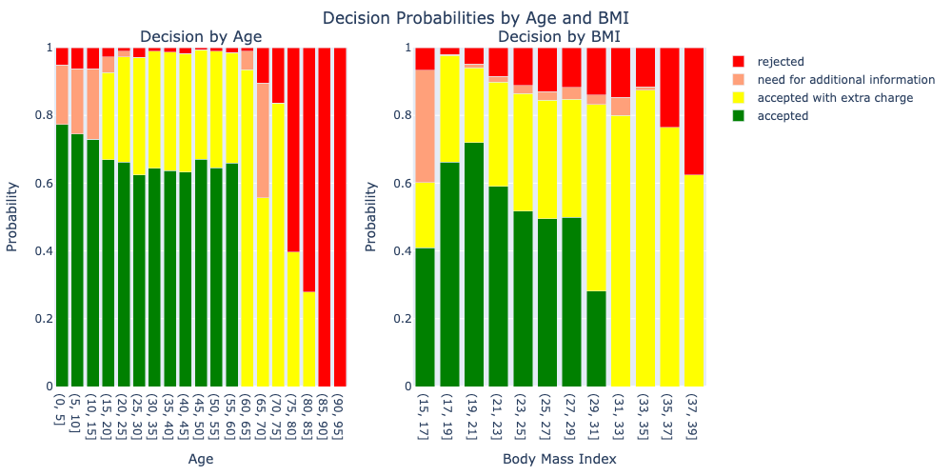
Analyzing Rules: Monte Carlo simulations

Slide 24

Analyzing Rules: Monte Carlo simulations

Slide 25
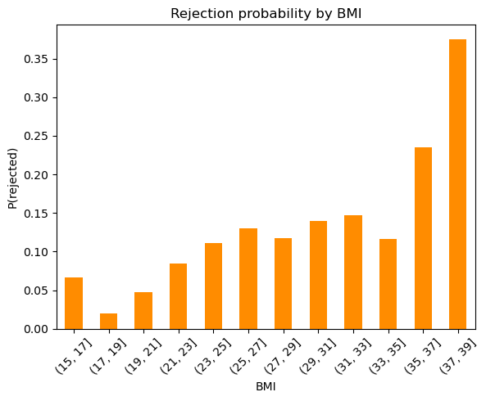
Analyzing Rules: Monte Carlo simulations

Slide 26
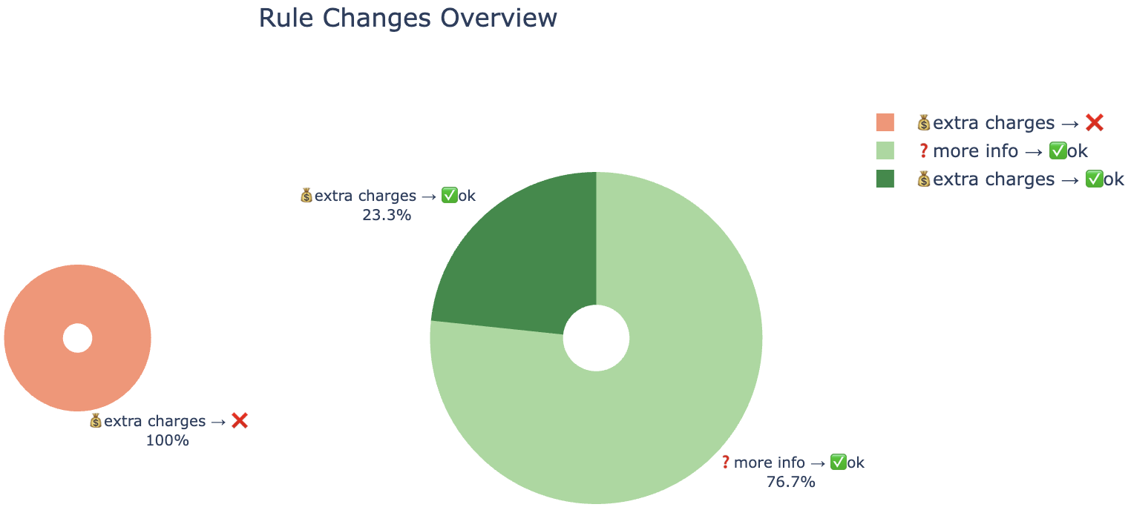
Analyzing Rules: Analyzing Changes of Rules

Slide 27
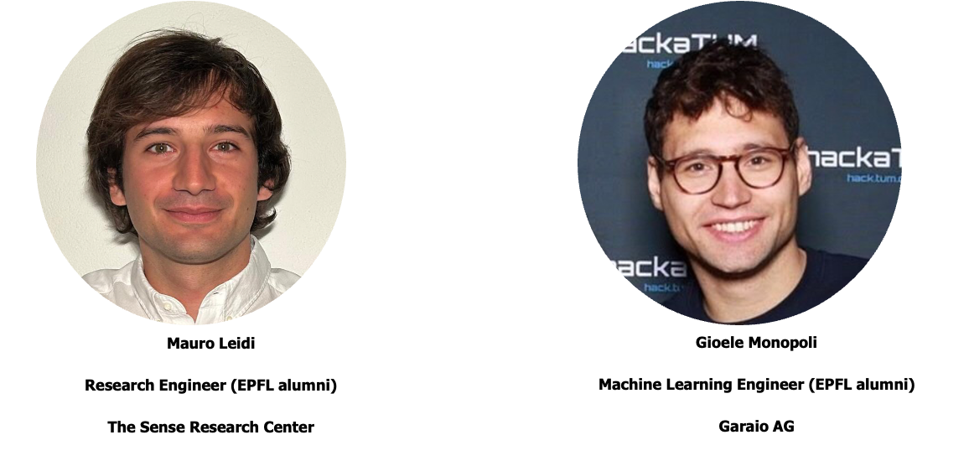
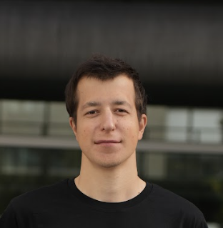

Analyzing Rules: Analyzing Changes of Rules
Dario Monopoli
MSc AI & DS @ UZH

